Slide 1
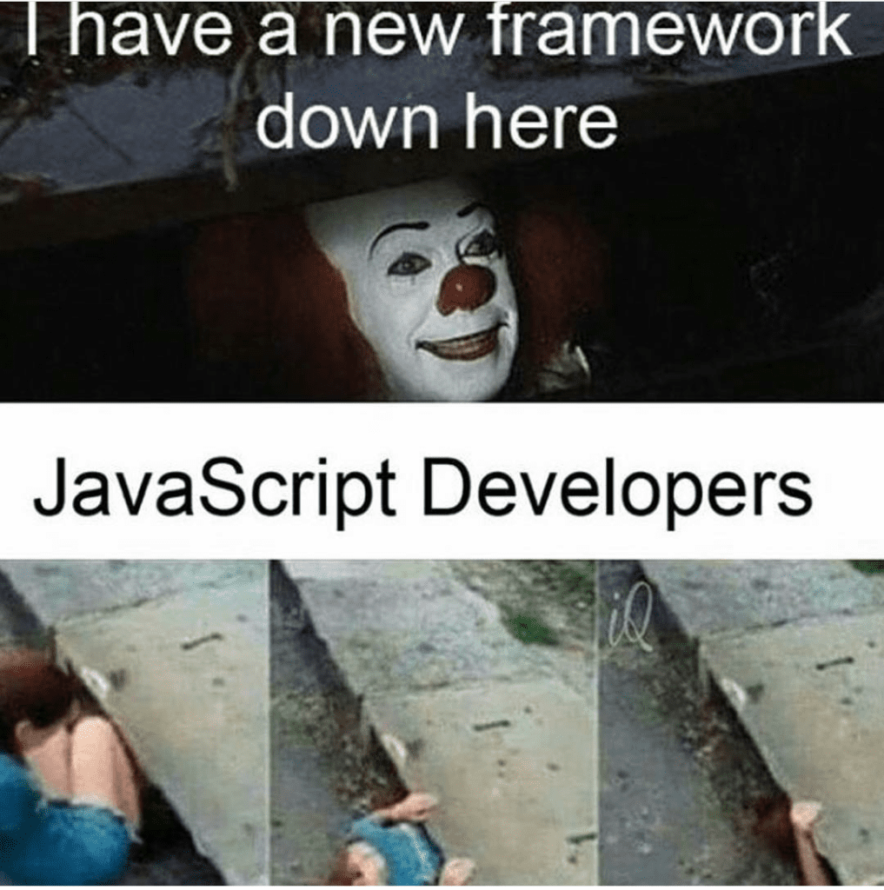
COMP1531 | T09B / H17B Week 2
william.huynh3@unsw.edu.au
npm package

Slide 2
Learning objectives
Reinforcing our understanding of JavaScript
Resolving merge conflicts
How to do well in this project as a Team
Optional: Objects … maybe???

Slide 3
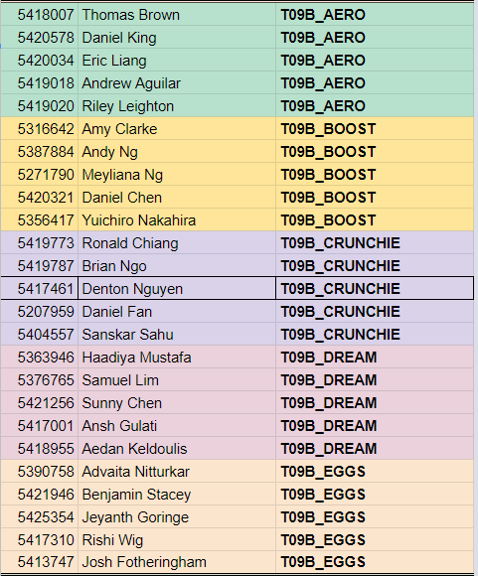
👨‍👩‍👧‍👦 T09B Finalised Groups

Slide 4
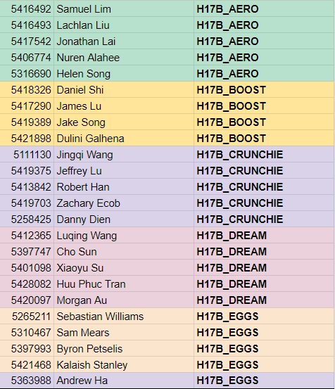
👨‍👩‍👧‍👦 H17B Finalised Groups

Slide 5
🏡PSA: Tutorial Marks
Attendance recorded starting Week 2
Tutorial participation and attendance contributes to your project mark

Slide 6
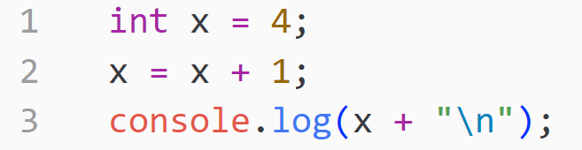

Slide 7
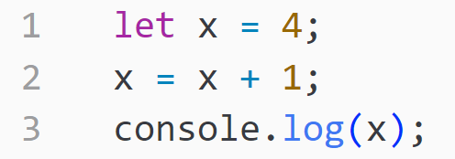


Slide 8
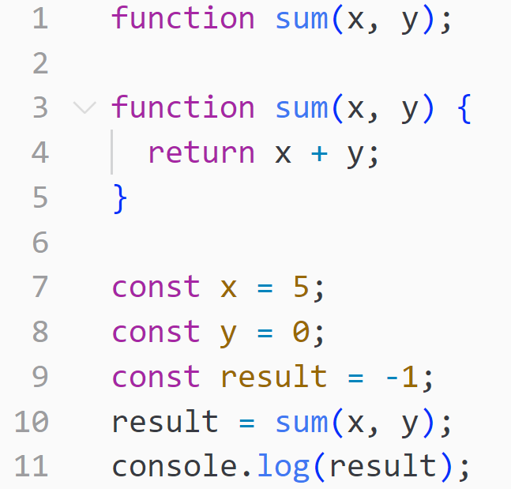

Slide 9
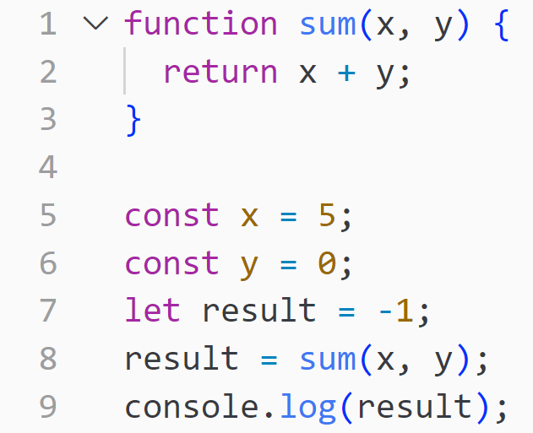

Slide 10
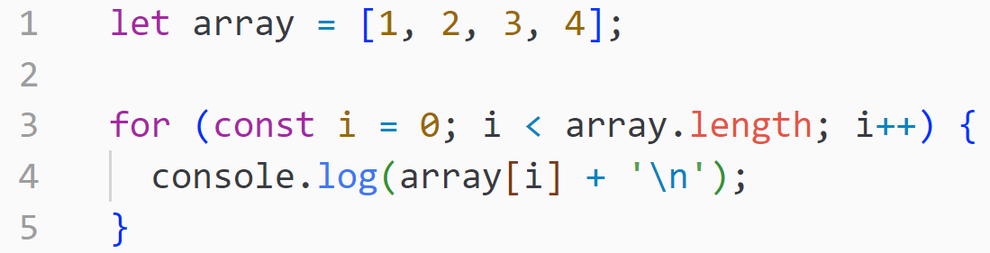

Slide 11
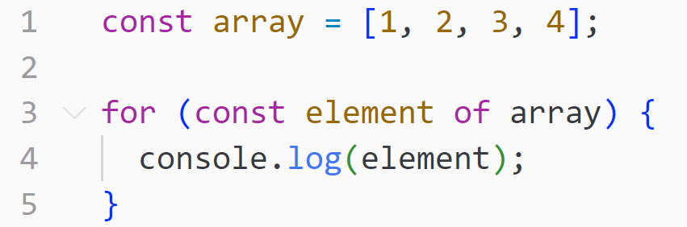

Slide 12
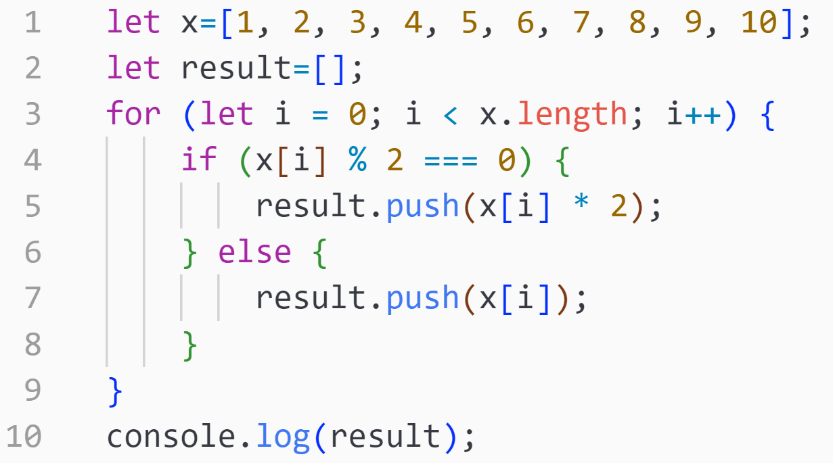
🧠 Code Review
In project groups, discuss the following:
What does the code do?
How can the style be improved?
How can we modify to code to be more javascripty?
Once you have some ideas, try re-write the code using the JavaScript practices you discussed.
To run your program:
node <your_file_name>

Slide 13
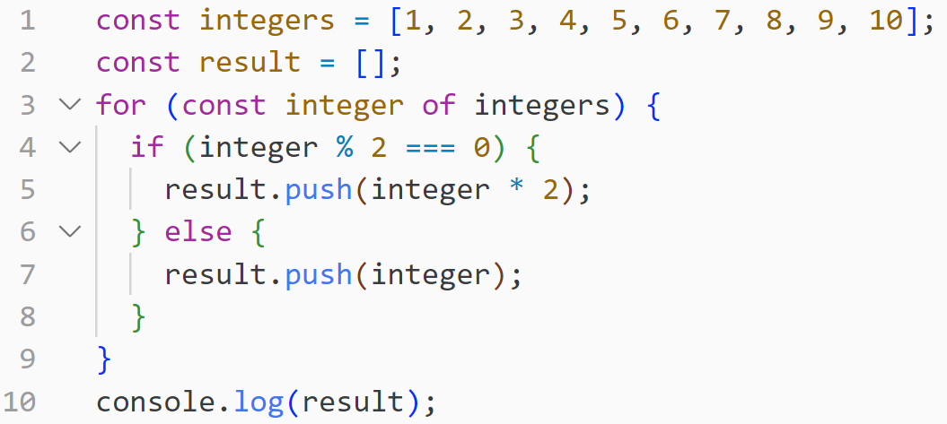
🧠 Code Review: A better solution

Slide 14
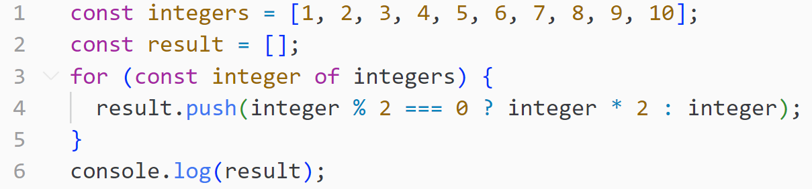
🧠 Code Review: An even better solution

Slide 15
🧠 Code Review: The best solution (week 4)

Slide 16
🌐 Git: An quick recap
git clone <git_url> | Downloads a Git Repository to your local computer
git add <your_file.js> | Take the ‘added’ files and record their changes, in preparation to be uploaded to Git
git commit -m “your message” | Take the ‘added’ files, and creates a snapshot of those files. They are now ready to be uploaded to Git.
git push | Uploads the ‘added’ files to Git
git pull | Downloads changed/new files from Git to your Local Computer

Slide 17

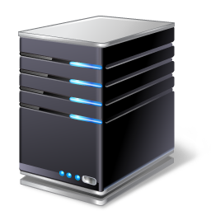
🌐 Git: An quick recap
Push
Pull
Git Server
authRegisterV1
John
authLoginV1
Jim
channelDetailsV1
Jane

Slide 18
🌐 Git: Merge Conflicts
Push
Pull
Git Server
authRegisterV1
John
They are working on the same function 😲
authRegisterV1
Jim
channelDetailsV1
Jane

Slide 19
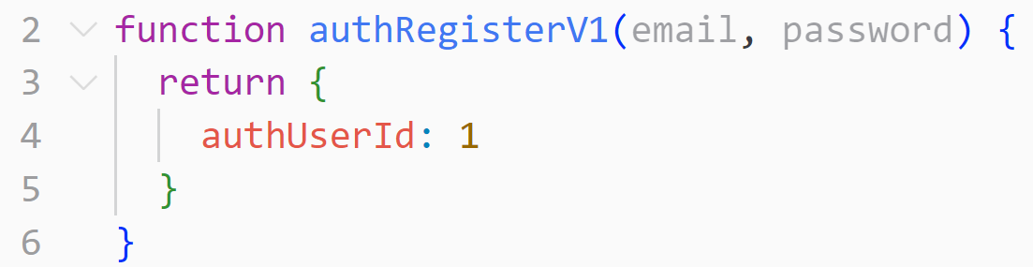
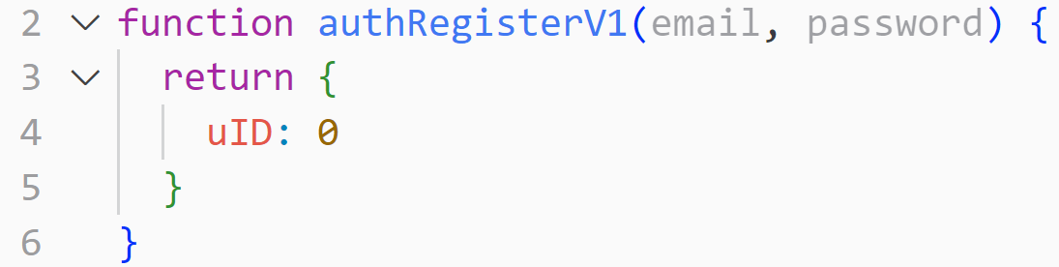
🌐 Git: Merge Conflicts
John
Jim
authRegisterV1
authRegisterV1
Git Server
Jane

Slide 20
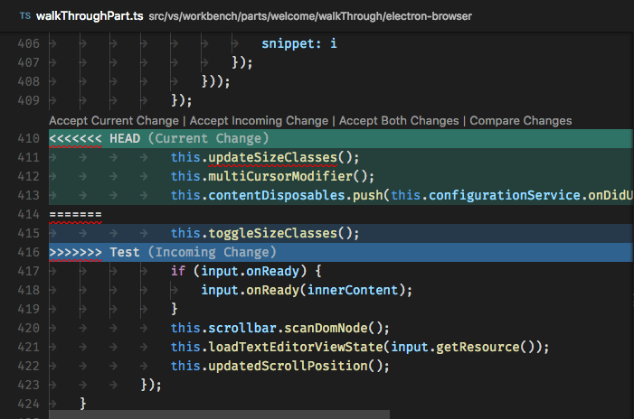
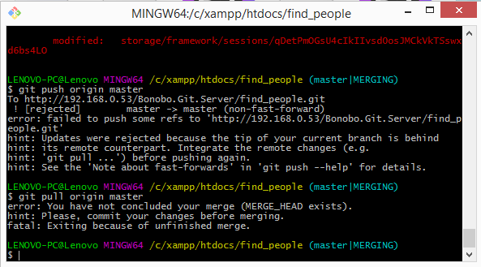
🌐 Git: Merge Conflicts
git pull
git push

Slide 21
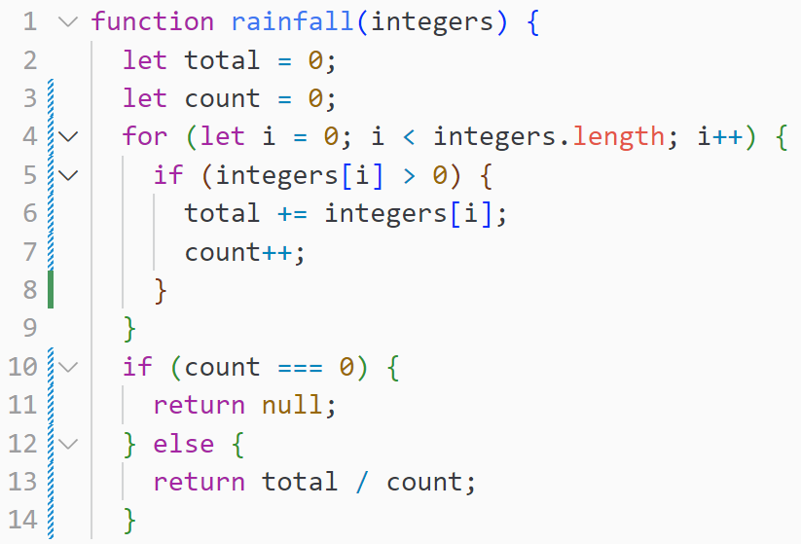
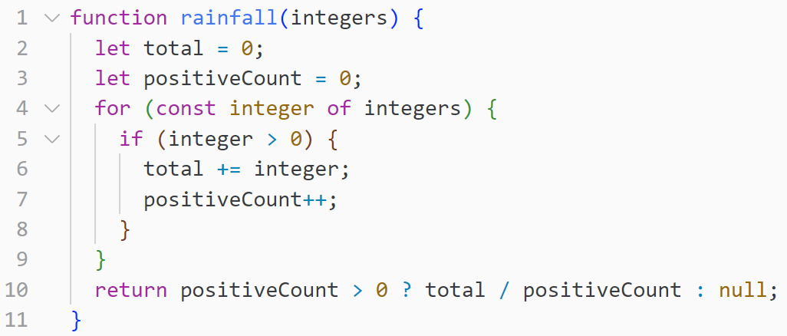
main branch
local branch

Slide 22
🌐 Git: Merge Conflicts
Create a local branch
Create a file called waterfall.js in that local branch and add the ‘for-of-loop’ code
Create a new file also called waterfall.js but in the master branch and add the ‘for-index-loop’ code
On our local branch, we will add, commit, and push, the code
See what happens….

Slide 23
🏡 Teamwork Principles
Brainstorm a list of good and poor attributes for team members working on a project.
Suppose there is a member in a group who has gone silent and has yet to complete much of their assigned work. The reason is unknown.
How should the remaining members approach the situation?
What can groups do beforehand such that if this occurs, they can manage or minimise the impact?

Slide 24

🏡 Be a good team member !!!
📢 Communication
⏰ Time Management
💕 Honesty
📋 Responsibility
✨ Enthusiasm (for your group + project!)

Slide 25
🏡 But what if…
A team member suddenly disappears without doing their work!
What should you do?
Immediately notify tutor AND allocate the work to backup group member(s)
Maintain contact with the group member (maybe a message a day)
Please don’t be aggressive
Document it (in meeting minutes)

Slide 26
👨‍👩‍👧‍👦 T09B Lab Project Check-Ins
10:20 - 10:40 AM
10:40 - 11:00 AM
11:00 - 11:20 AM
11:20 - 11:40 AM
11:40 - 12:00 PM

Slide 27
👨‍👩‍👧‍👦 H17B Lab Project Check-Ins
6:20 - 6:40 PM
6:40 - 7:00 PM
7:00 - 7:20 PM
7:20 - 7:40 PM
7:40 - 8:00 PM

Slide 28
👨‍👩‍👧‍👦 H17B Holiday Lab Project Check-Ins
2:00 - 2:20 PM
2:20 - 2:40 PM
2:40 - 3:00 PM
3:00 - 3:20 PM
3:20 - 3:40 PM

